Slide 1
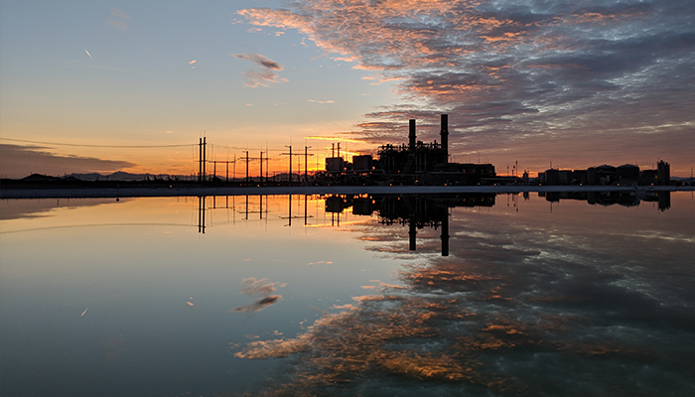
2017 Annual Report for the
Arizona Environmental Strategic Alliance

Slide 2
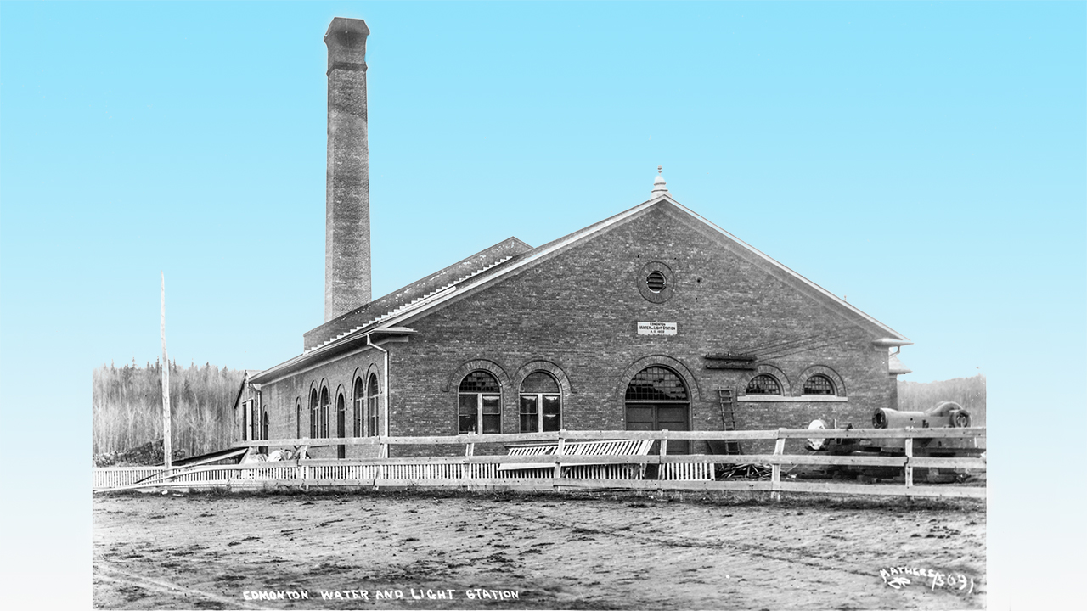
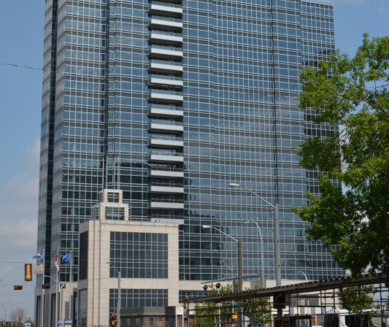
Capital Power History
1891 Edmonton Electric Light and Power Company (private)
1902 Bought by City of Edmonton
1903 Built first water treatment plant became Edmonton Water and Light Company
1970 Electrical distribution and power plant departments combine - named Edmonton Power
1996 EPCOR is formed (natural gas, power and water utilities)
2009 Capital Power is formed by spinoff of EPCOR’s Power generation division. Now a publicly traded company
2018 Capital Power purchased Arlington Valley Energy Facility
Notes:
Simple Cycle Plant
2 GE LMS100 – 100MWs each
1 GE LM6000 – 43MW
243 MW total

Slide 3
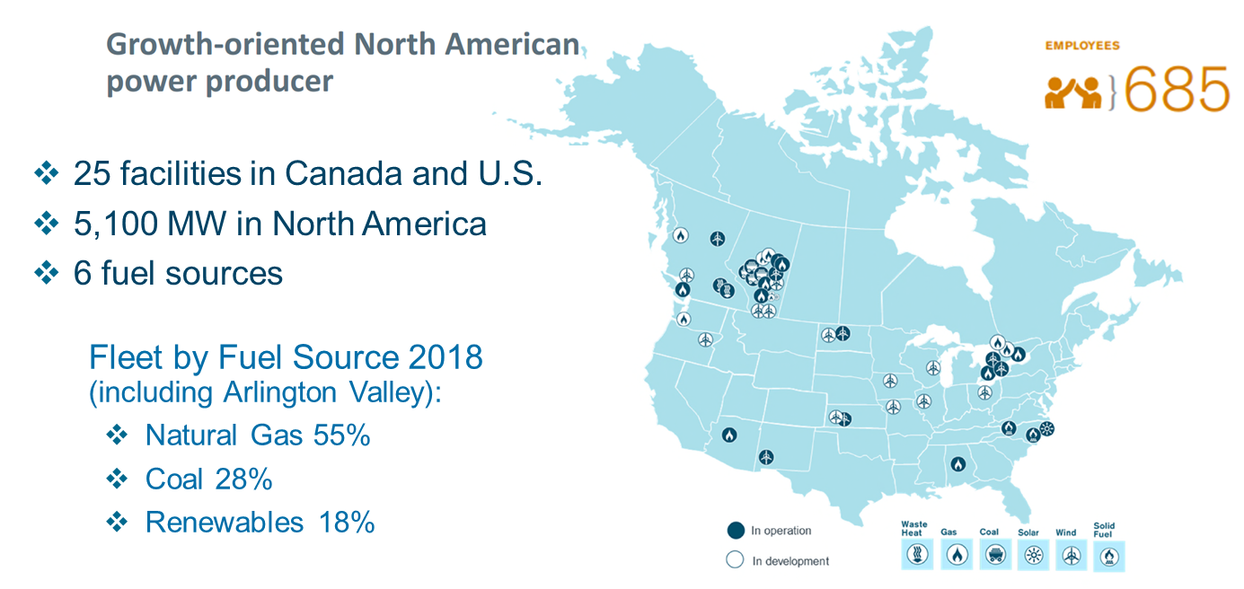
Capital Power Footprint

Slide 4
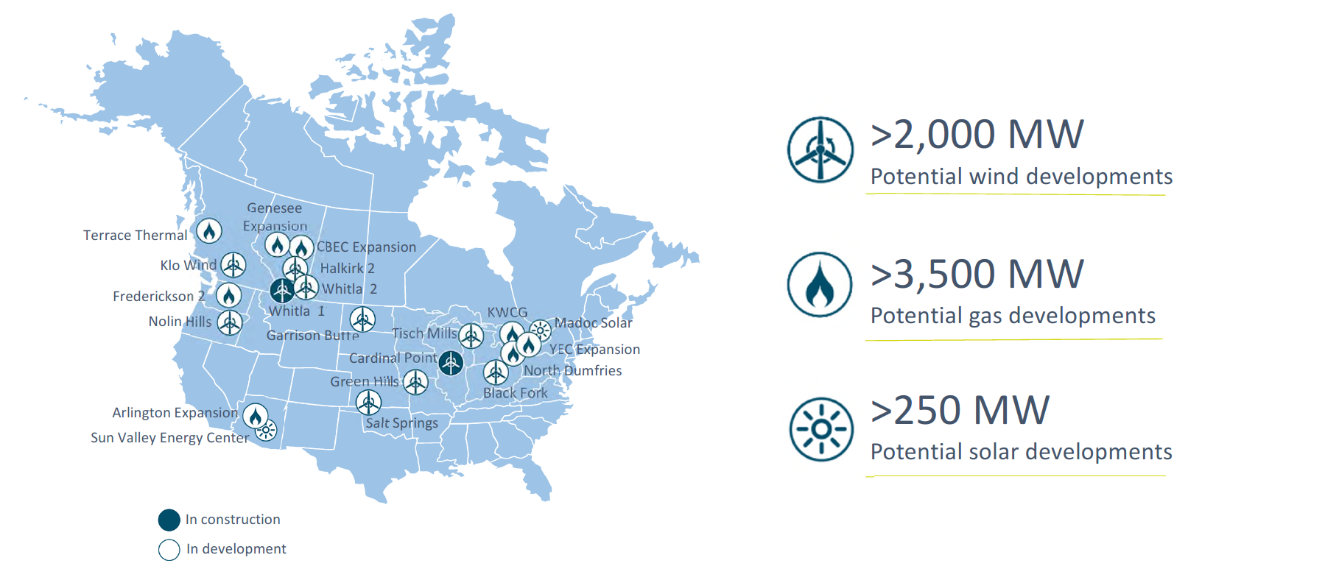
Capital Power’s Future includes Growth for Arizona

Slide 5
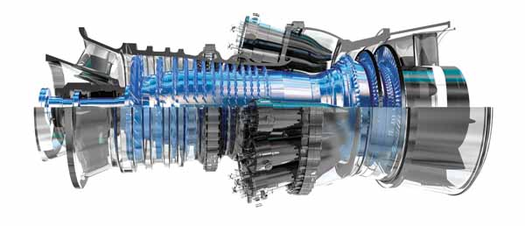
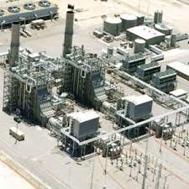
Arlington Valley
Facility utilizes two natural gas-fired generating turbines to generate power directly
Each gas turbine has a Heat Recover Steam Generator (HRSG) that produces steam which is used to generate more electricity through a steam turbine generator, dramatically increasing efficiency of the overall design
Total power production capacity is 580 Megawatts
That is enough power for nearly half a million homes
Combined cycle natural gas plants
Twice as efficient on an emissions basis (CO2) than conventional simple cycle electric production plants, and even more so than coal
Notes:
Simple Cycle Plant
2 GE LMS100 – 100MWs each
1 GE LM6000 – 43MW
243 MW total

Slide 6
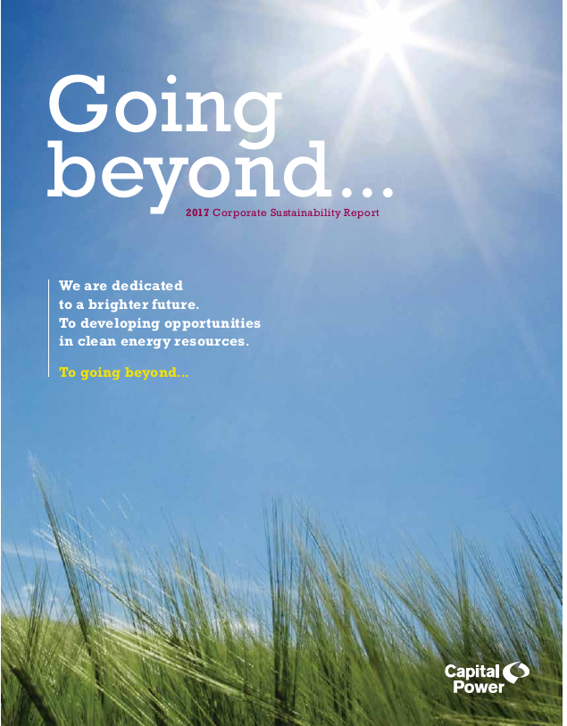
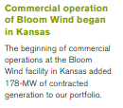
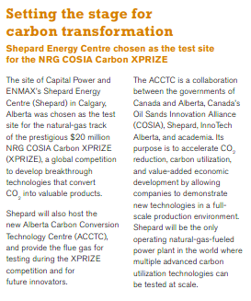
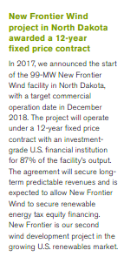
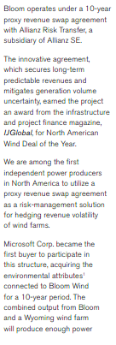
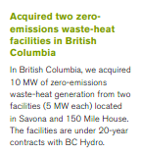
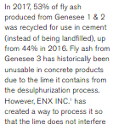
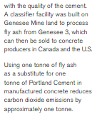

Slide 7
Arlington’s Environmental Policies mirror Capital Power’s Focus Areas
Arlington Valley Energy Facility has produced and maintains a comprehensive environmental management system and audit program
Since 2010, there has been an extensive review and update to AVEF environmental policies
The plant has undergone several third-party environmental program reviews with no significant findings in any case
AVEF has several posted EH&S policies that are strictly adhered to and advocated by management
Extensive training processes are in place to ensure that employees and contractors understand the expectations of maintaining an environmentally conscious workplace
AVEF strives to maintain an open relationship with regulatory agencies and personnel
We have had no environmental violations during the past year, and we look forward to continuing that record into the future
Updated Title V Air Permit and our Aquifer Protection Permit in 2017 and 2018

Slide 8
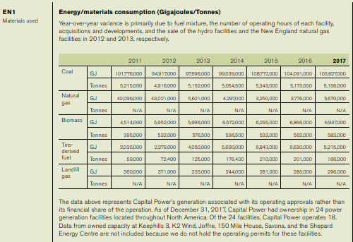
Capital Power & Global Reporting Initiative (GRI)
Capital Power is a publicly traded company that submits a Corporate Sustainability
Report which follows guidelines defined the Global Reporting Initiative (GRI 3.1)
Arlington’s Environmental Statistics will be rolled into this annual report. Capital Power has a unique leading edge Key Performance Indicator Program that affects all personnel at Capital Power. Every employee at Capital Power from the CEO to the mail clerk participates in these initiatives and programs.

Slide 9
Arlington’s Conservation & Pollution Prevention
Arlington Valley Energy Facility was designed and built to minimize water use and discharges to the environment
Trip Reduction of the gas turbines minimizes the higher emissions experienced during shutdown and start up.
The plant processes have been optimized to reduce waste of all types, and the site is a conditionally exempt small quantity generator (CESQG) of hazardous waste
Despite being an electricity generator, the plant is always looking for best practices in the use and conservation of electricity
Arlington Valley Energy Facility has restored a vast amount of former agricultural land, and has created and maintains a wetland area for the support of migratory water fowl in the Hassayampa River basin

Slide 10
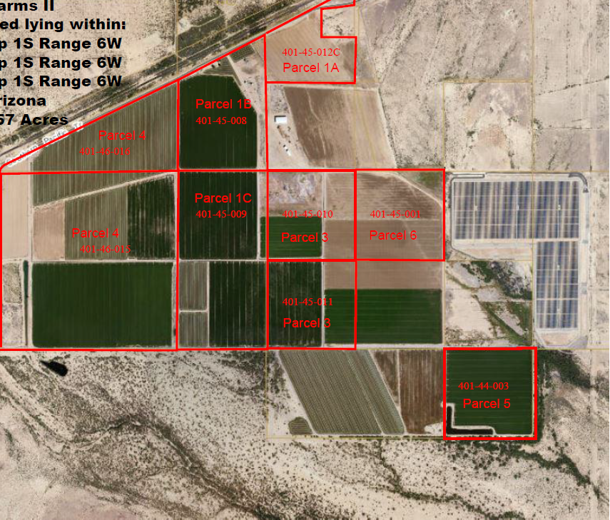
Arlington’s Agricultural Land Reclamation
AVEF maintains a 17 acre wetland that is utilized by a number of species of waterfowl, many of which are identified as Birds of Management Concern
Of note, the facility has increased the amount of water to the wetlands and changed the timing of the wetlands flooding in 2017. We have seen an increase in the number of Migratory waterfowl in the last few years and they are coming earlier in the season. We now flood the wetlands from late October until March of each year.
More than 1,200 acres of the 2,800 site have been recovered and restored to a natural state of which approximately 320 acres is used as open grazing pasture for nearby ranchers.
AVEF renewed our lease allowing over 520 acres of the 2,800 site to be used for farming in 2017.
520 acres actively farmed

Slide 11
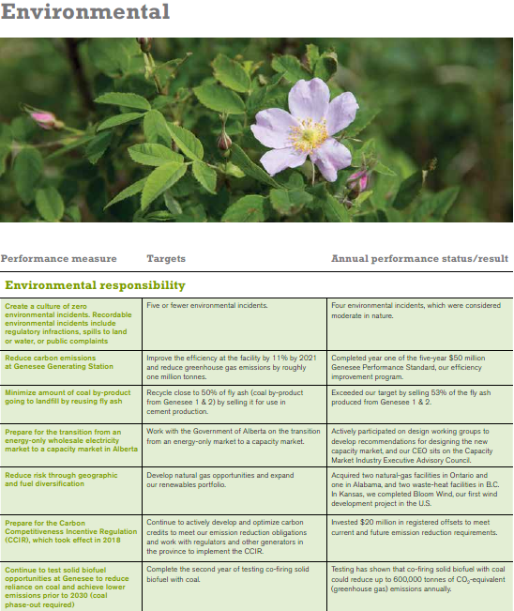
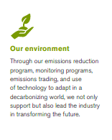
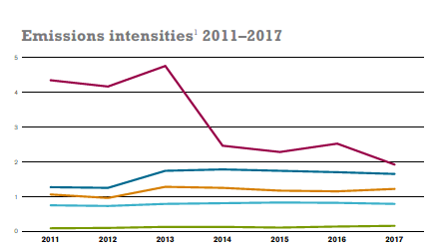
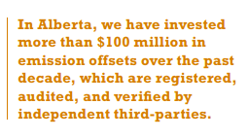
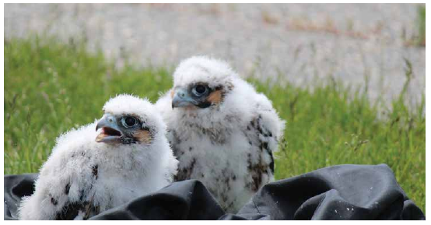
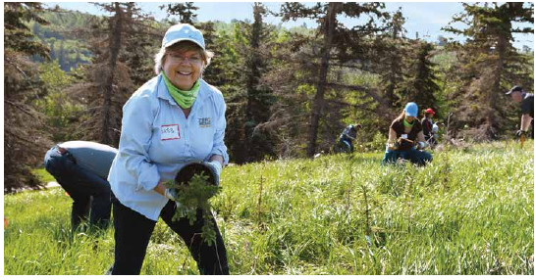
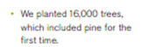
Capital Power’s Environment
At Capital Power, we work to minimize our impacts and create long-term sustainability by implementing land reclamation and reforestation practices, respecting wildlife, working together in partnerships, and supporting research.

Slide 12
Arlington’s Annual Recycle and Waste Reduction
More than 4,500 lbs of electronics and office waste was recycled in 2017, increased from the previous year due to upgrades.
We were also able to repurpose over 300 lbs of electronics by reusing switches and relays in non-critical areas.
AVEF recycled 38,000 lbs of large battery banks in 2017
120 facility backup batteries failed for the second time in 4 years, which is well before their expected end of life. Investigation showed that the installed battery charger system did not match design specs. We recycled the batteries and modified the system to ensure that the new batteries will last for their design life of 7-10 years before replacement is required. Although unexpected, we should not have to recycle this 26,000 lbs again until 2025.
We also recycled 12,000 lbs of wet cell generator backup batteries that were replaced on the gas turbines. The new batteries chosen have a 20 year life span which is 25% longer than the previous version. This was a planned evolution.
Work is ongoing for changing plant lighting from sodium and fluorescent to LED
An additional 40 fluorescent lamps have been removed from service and recycled in 2017. Due to our efforts in this area over the last two years, we only had to recycle the 40 bulbs upgraded this year.
Each fluorescent lamp replaced by an LED lamp saves nearly 40 Watts in power consumption

Slide 13
Arlington’s Water Conservation Efforts
AVEF is designed for maximum water and power efficiency
Combined Cycle plants use considerably less water than conventional steam generating plants
AVEF has a complex water treatment system that provides for significant recycling and reuse of the cooling water, which reduces water makeup requirements
AVEF has implemented a number of projects in 2017 that allowed the facility to use the same amount of water as we have averaged over the last 2 years despite a 10% increase in power production over the same period. We decreased the cooling tower blowdown to the ponds from ~80GPM to 50 GPM.
In general terms, water usage is proportional to power production. AVEF has used 10% less water year over year despite increasing production 10%.
AVEF water usage reduction was coupled with a few projects to minimize waste water to our evaporative ponds. As a zero liquid discharge facility, AVEF has hard limits on how much waste water we can produce. The facility was able to minimize the amount of waste water to the ponds while achieving our record setting power production year.
AVEF is still evaluating water recycling technologies to reduce our water usage and waste water production further.
2017 Pilot program that EPRI conducted at a similar facility ultimately deemed not viable at Arlington
KMX Vacuum Membrane Distillation Project Pilot Trial at Arlington Valley initiated for 2018
The Future, Capital Power expects to increase our capacity during the year and we are looking at all options

Slide 14
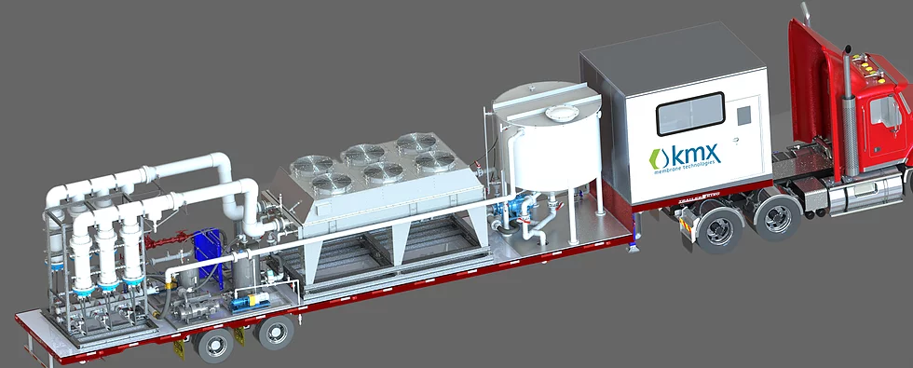
Arlington’s KMX Project Trial
KMX approached Arlington in 2017
They were looking for a facility where they could try to upsize their project and show proof of technology.
They wanted to show proof of concept for a 100GPM system
They needed high salt concentration like Arlington’s Evap Ponds at 168,000 mg/L TDS
KMX Provided a Mobile Distillation Unit
Treated 1200 gallons of pond water over a three week period at a rate of 4-6 GPM permeate production.
46% of the pond water was recovered at a quality level of <30 ppm TDS and reused in the water plant
~80% Direct Cooling Tower Blowdown recovery during the summer trial. We estimate that we could decrease our water to the pond from 50 GPM to 25 GPM on an annual average basis.
This is a big deal if we increase our Operations as expected over the next few years.

Slide 15
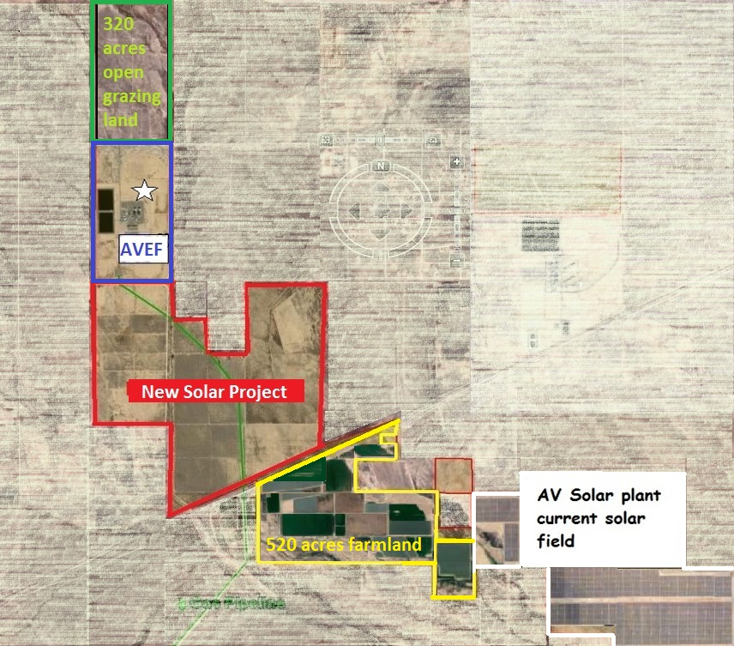
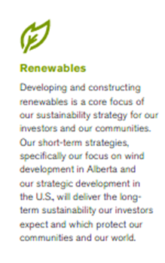
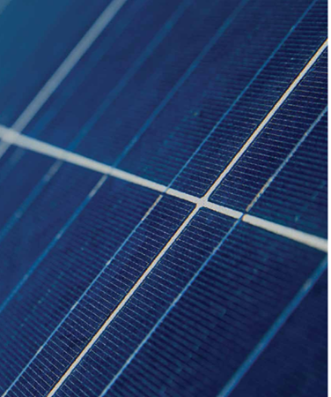
Arlington’s Renewable Energy Support
AVEF entered into a lease with Sempra to build an additional solar power generation field on 890 acres of our property . This project will double the amount of solar fields supported by our land.

Slide 16
Arlington’s Education and mentoring
Arlington Valley Energy Facility works with many organizations to share ideas that will enhance all parties’ environmental achievements
Arlington Valley has taken part in the Clean Power Plan stakeholders’ process with the ADEQ in order to maximize the positive impact of the final ruling on Arizona businesses
Arlington Valley was an original member of the California Climate Registry, and continues to support this innovative effort
Power plant & environmental chemistry committee
The PPEC is a research group focused on advances and best practices in the areas of chemistry and environmental management at power plants
The PPEC maintains a membership of approximately 120 professionals from all across the United States and abroad
Affiliated with and supported by the Electric Power Research Institute

Slide 17
Internships & The Future
Last year I reported a bit about our most exciting mentoring project involving summer interns and the Big “What If” Question. How can we save water at Arlington Valley.
I’ve previously reported on how some of the solutions from our interns have been implemented to greatly reduce our water to our Evaporation Ponds.
In 2017 we had an increase in unit capacity of ~10%, which means we put 10% more process waste water to the ponds. Due to efforts identified by employees and interns, we saved that 10% in the water processing and did not put more water to the ponds.
In 2018 we had the same higher run profile, but this year our pond levels went down…
We hired our 2016 summer intern as our full time Plant Engineer
As the Plant Engineer, he had an opportunity to implement one of his suggestions for water waste reduction and work on the water trial over the summer.
Capital Power has an annual internship program called SWEP in Alberta (Summer Work Experience Program) but they also are open to discussions regarding interns outside of Alberta.

Slide 18
Arlington Valley is a Good Neighbor
AVEF personnel take part in numerous training events, and maintain open informational exchange with our neighbors, both geographically and industrially in order to share information and best practices so that we can all find new ways to improve our policies in safety and environmental management.
AVEF participated in a national range land study of portions of our land conducted by he US Department of Agriculture Natural Conservation Services. They are taking an inventory of natural resources and habitats around the country.
Arlington Valley spear headed an initiative to foster networking between local 7FA facility staffs to discuss items of mutual interest quarterly in 2017. The first meeting of the “West Valley 7FA Meeting” in January of 2017 was a huge hit. We had the entire management staff from Mesquite, Red Hawk, Gila and Arlington Valley in one. We talked about our units, our EHS programs, and major project initiatives like water conservation.
I’m pleased to report that these meetings have grown and we had to change the name from West Valley 7FA Meeting to the Arizona Power Plant Meeting because SRP wanted to send all their facility Plant Manager Teams and we invited our affiliated plant from Kingman.

Slide 19
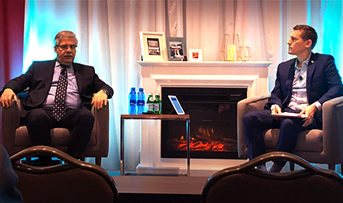
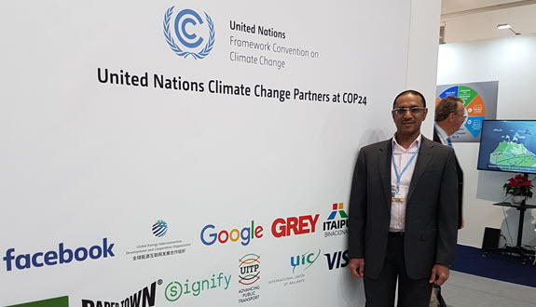
Capital Power is a good neighbor
COP24 in Katowice, Poland offers insight and future direction for the energy industry
Capital Power joined government and industry players at the 24th Conference of the Parties to the United Nations Framework Convention on Climate Change, also known as COP24, from Dec. 2-14, 2018. Negotiators from 196 counties and the European Union worked to develop the Katowice Climate Package, which implements the Paris Agreement.
Delivering a Sustainable Future
Capital Power CEO Brian Vaasjo spoke at the CIBC 22nd Annual Whistler Institutional Investor Conference.

Slide 20
Questions?
2017 Annual Report for the
Arizona Environmental Strategic Alliance

